Slide 1
Week 07 – Lecture 2 Stack - Applications
Algorithms and Data Structures (CIS1002-N)
Dr Qiang Guo
Q.Guo@tees.ac.uk

Slide 2
Week | Lecture (1hour) | IT Lab (2 Hours)
1 | Arrays as Abstract Data Types (ADT) | Arrays Scanning Exercises
2 | Sorting Algorithms – Bubble Sort & Cocktail-Shaker Sort | ArrayADT
3 | Selection Sort, Insertion Sort, and Big-O Notation | Sorting Algorithms
4 | Singly Linked Lists | Selection Sort and Insertion Sort
5 | Circular Linked Lists | Linked Lists
6 | Doubly Linked Lists | Circle Linked Lists
7 | Stack | Doubly Linked Lists
8 | Queues | Stacks
9 | Recursion | Queues
10 | Recursion & ICA Focus | Recursion I
 | Easter Breaks
11 | Trees & ICA Support | Recursion II
12 | Trees & ICA Support | Trees & ICA Progress Advice & Reminders
13 | ICA Hand-in (10th May 2023 by 4pm)

Slide 3
Stack applications
Page-visited history in a Web browser
Undo sequence in a text editor
In this session, we will demonstrate
Saving local variables when one function calls another, and this one calls another, and so on.
Very important for compiling and runtime processing!
Checking a file to see if braces {} and other operators are balanced.
Very import for checking the correctness of programming syntax!
Reverse a string
Translate an integer string to an integer value, e.g., "123" -> 123
Translate an integer value to an integer string, e.g., 123 -> "123".

Slide 4
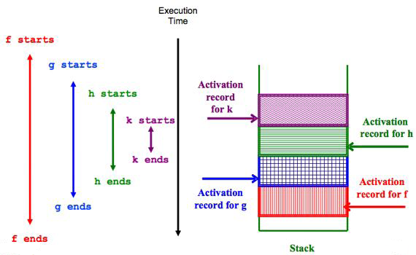
Store method activation records
void f(){
g();
}
void g(){
h();
}
void h(){
k();
}
void k(){
…
}

Slide 5
Store method activation records (cont.)
main() { int i;
i = 5; c(i); }
c(int j) { int k; k = j+1; d(k); }
d(int m) { return m+1; }
The system keeps track of the chain of active methods with a stack
When a method is called, the system pushes on the stack a frame containing
Local variables and return value
Program counter, keeping track of the statement being executed
When a method returns, its frame is popped from the stack and control is passed to the method newly on top of the stack.
PC stands for program call
d
PC = 3 m = 7
c
PC = 2 k = 6
j = 5
main
PC = 1 i = 5

Slide 6
Balanced brackets
Given an arbitrary string of characters, determine if any brackets such as "(", "[", "<" are closed in the correct order (i.e. balanced): [ hello ( world < ! > ) ] → Balanced [ hello ( world < ! > ) ) → Not Balanced
An empty string is considered Balanced
Obvious use: Programming languages!

Slide 7
Balanced brackets - [ hello ( world < ! > ) ]
[
h
e
l
l
o
(
w
o
r
l
d
<
!
>
)
]
Stack empty – brackets are balanced
Stack
<
(
Top
[

Slide 8
Balanced brackets - [ hello ( world < ! > ) )
[
h
e
l
l
o
(
w
o
r
l
d
<
!
>
)
)
Stack
Error!
Stack not empty – brackets not balanced
<
(
Top
[

Slide 9
Algorithm to check balanced symbols
To check that every right brace, bracket, and parentheses corresponds to its left counterpart
e.g. [( )] is correct, but [( ] ) is not correct.
Algorithm
Make an empty stack.
Read characters until end of file.
If the character is an opening symbol, push it onto the stack.
If it is a closing symbol and the stack is empty, report an error.
If it is a closing symbol and the stack is not empty, pop the stack.
If the symbol popped is not the corresponding opening symbol, then the expression is not balanced.
At end of file, if the stack is not empty, report an error.

Slide 10
Reverse a string
H
e
l
l
O
,
w
o
r
l
d
!
l
o
,
w
o
r
l
d
!
e
l
L
o
,
w
o
r
l
d
!
!
l
l
o
,
w
o
r
l
d
!
o
,
w
o
r
l
d
!
o
,
w
o
r
l
d
!
w
o
r
l
D
!
!
,
w
o
r
l
d
!
w
o
r
l
d
!
d
!
l
d
!
w
o
r
l
D
!
r
l
d
!
H
e
l
l
o
,
w
o
r
l
d
!
r
l
d
!
o
r
l
d
!
e
l
l
o
,
w
o
r
l
d
!
d
!
l
d
!
o
r
l
d
!
,
w
o
r
l
d
!
l
o
,
w
o
r
l
d
!
l
l
o
,
w
o
r
l
d
!
w
o
r
l
d
!
"!dlrow ,olleH":
This is the reversed string of "Hello, world! "
Push …
Pop …
Hello,
Hello, worl
Hello, wo
Hell
Hello, world!
H
Hello, world
Hello
He
Hello, w
Hel
Hello, wor
Hello,

Slide 11
Parsing an integer string
When you type (from your keyboard) an integer 12345, the inputs are an ordered and concatenated sequence of characters "1" "2" "3" "4" "5" "6".
Question:
How can a computer system recognize "123456" as
one hundred twenty-three thousand, four hundred fifty-six (123456).
If you use Java, you have a string method String.parseInt("123456").
If you use Python, you have a built-in function int("23456").
How can you write your own function to parse "123456" to its integer value?

Slide 12
Parsing an integer string
"123456" => {"1", "2", "3", "4", "5", "6"}
String.parseInt("0") => 0
String.parseInt("1") => 1
String.parseInt("2") => 2
String.parseInt("3") => 3
String.parseInt("4") => 4
String.parseInt("5") => 5
String.parseInt("6") => 6
String.parseInt("7") => 7
String.parseInt("8") => 8
String.parseInt("9") => 9
123456 = 12345*10 + 6
123456 = (1234*10 + 5)*10 + 6
123456 = ((123*10 + 4)*10 + 5)*10 + 6
123456 = (((12*10 + 3)*10 + 4)*10 + 5)*10 + 6
123456 = ((((1*10 + 2)*10 + 3)*10 + 4)*10 + 5)*10 + 6

Slide 13
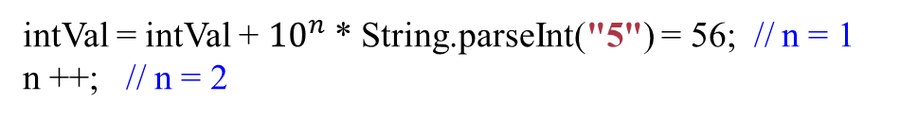
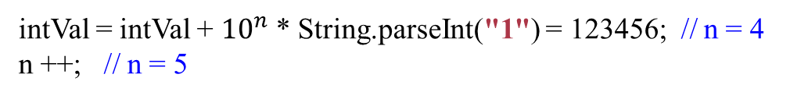
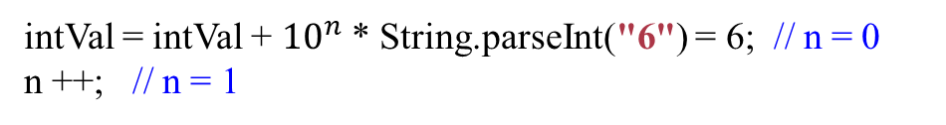
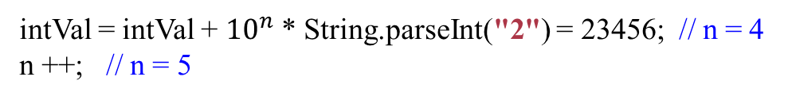
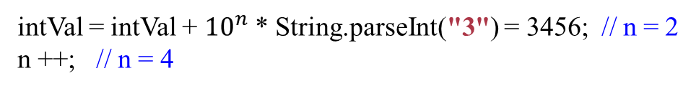
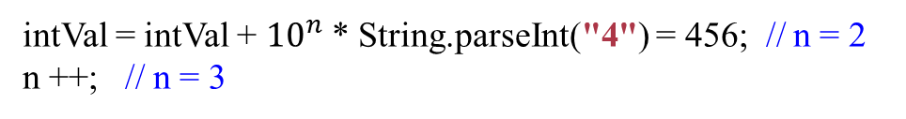
Parsing an integer string (cont.)
"123456":
{"1", "2", "3", "4", "5", "6"}
intVal = intVal + ${10}^{n}$ * String.parseInt("6") = 6; // n = 0
n ++; // n = 1
intVal = intVal + ${10}^{n}$ * String.parseInt("5") = 56; // n = 1
n ++; // n = 2
int intVal = 0
int n = 0
"6"
"5"
"4"
"3"
"2"
"1"
intVal = intVal + ${10}^{n}$ * String.parseInt("4") = 456; // n = 2
n ++; // n = 3
"3"
"2"
"1"
"2"
"1"
"1"
"4"
"3"
"2"
"1"
"5"
"4"
"3"
"2"
"1"
Push …
intVal = intVal + ${10}^{n}$ * String.parseInt("3") = 3456; // n = 2
n ++; // n = 4
Pop …
intVal = intVal + ${10}^{n}$ * String.parseInt("2") = 23456; // n = 4
n ++; // n = 5
intVal = intVal + ${10}^{n}$ * String.parseInt("1") = 123456; // n = 4
n ++; // n = 5
"123456" => 123456

Slide 14
Convert an integer to a string
123456 => "123456"
The modulo (or "modulus" or "mod" or "%") is the remainder after dividing one number by another.
Example: 100 % 9 equals 1
Because 100/9 = 11 with a remainder of 1
"123456" = "12345" + "6"
"123456" = "1234" + "5" + "6"
"123456" = "123" + "4" + "5" + "6"
int value = 123456
"123456" = "12" + "3" + "4" + "5" + "6"
value / 10 = ?
value / 10 = 12345
value % 10 = ?
value % 10 = 6
"123456" = "1" + "2" + "3" + "4" + "5" + "6"

Slide 15
Convert an integer to a string (cont.)
int intVal = 123456
String s
"5"
"6"
"6"
"4"
"5"
"6"
"3"
"4"
"5"
"6"
"2"
"3"
"4"
"5"
"6"
s = Integer.toString(intVal % 10) // s = "6"
intVal = intVal / 10; // intVal = 12345
"1"
"2"
"3"
"4"
"5"
"6"
s = Integer.toString(intVal % 10) // s = "5"
intVal = intVal / 10; // intVal = 1234
Pop and link all chars
Push s
If intVal == 0
s = Integer.toString(intVal % 10) // s = "4"
intVal = intVal / 10; // intVal = 123
s = Integer.toString(intVal % 10) // s = "3"
intVal = intVal / 10; // intVal = 12
s = Integer.toString(intVal % 10) // s = "2"
intVal = intVal / 10; // intVal = 1
"123456"
s = Integer.toString(intVal % 10) // s = "1"
intVal = intVal / 10; // intVal = 0

Slide 16

Backtracking in a maze
Junction
Find a way to reach a goal
One strategy would be to try going through Portion A of the maze.
If you get stuck before you find your way out, then you "backtrack" to the junction.
At this point in time, you know that Portion A will NOT lead you out of the maze,
so, you then start searching in Portion B
Portion B
Goal
Portion A

Slide 17

Backtracking in a maze (cont.)
Clearly, at a single junction you could have even more than 2 choices.
The backtracking strategy says to try each choice, one after the other,
if you ever get stuck, "backtrack" to the junction and try the next choice.
If you try all choices and never found a way out, then there IS no solution to the maze.
Junction
C
B
A

Slide 18
Backtracking in a maze (cont.)
dead end
?
dead end
dead end
?
start
?
?
dead end
dead end
?
success!

Slide 19
Summary
This session covers:
Stack data structure and its implementations.
Implementing a stack in an array
Implementing a stack in a linked list.
Stack applications.
Reverse a sting in stack.
Check the brackets and other operators are balanced.
Parsing an integer string to an integer value.
Converting an integer value to an integer string.
Next week:
Another ADT - Queue.

Slide 20


Questions?
Thank you!
Stack Implementation and applications
Week 07

